Slide 1


CS305
Final Project
Presentation
组员：冯大志，杨家鉴，徐璟源

Slide 2

01
Design Introduction

Slide 3
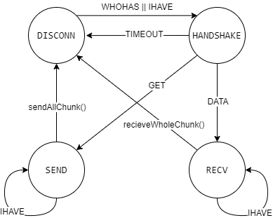
[(team number, ip, port, state)] -> records other peers
rdt_timer -> RDT timeout
GET_timer -> GET Packet Timeout

Slide 4
P3
P2
P4
P4
IHAVE:4
P1
P5
P1
P5
IHAVE:3
IHAVE:3
WHOHAS: 3,4
WHOHAS: 3,4
WHOHAS:3,4
WHOHAS: 3,4
P0
WHOHAS:3,4
P0
Demand list: [chunk3,chunk4]

Slide 5
P3
P2
P4
DATA
P5
P1
P5
DATA
GET:4
GET:3
P0
DENIED
Demand list: []

Slide 6
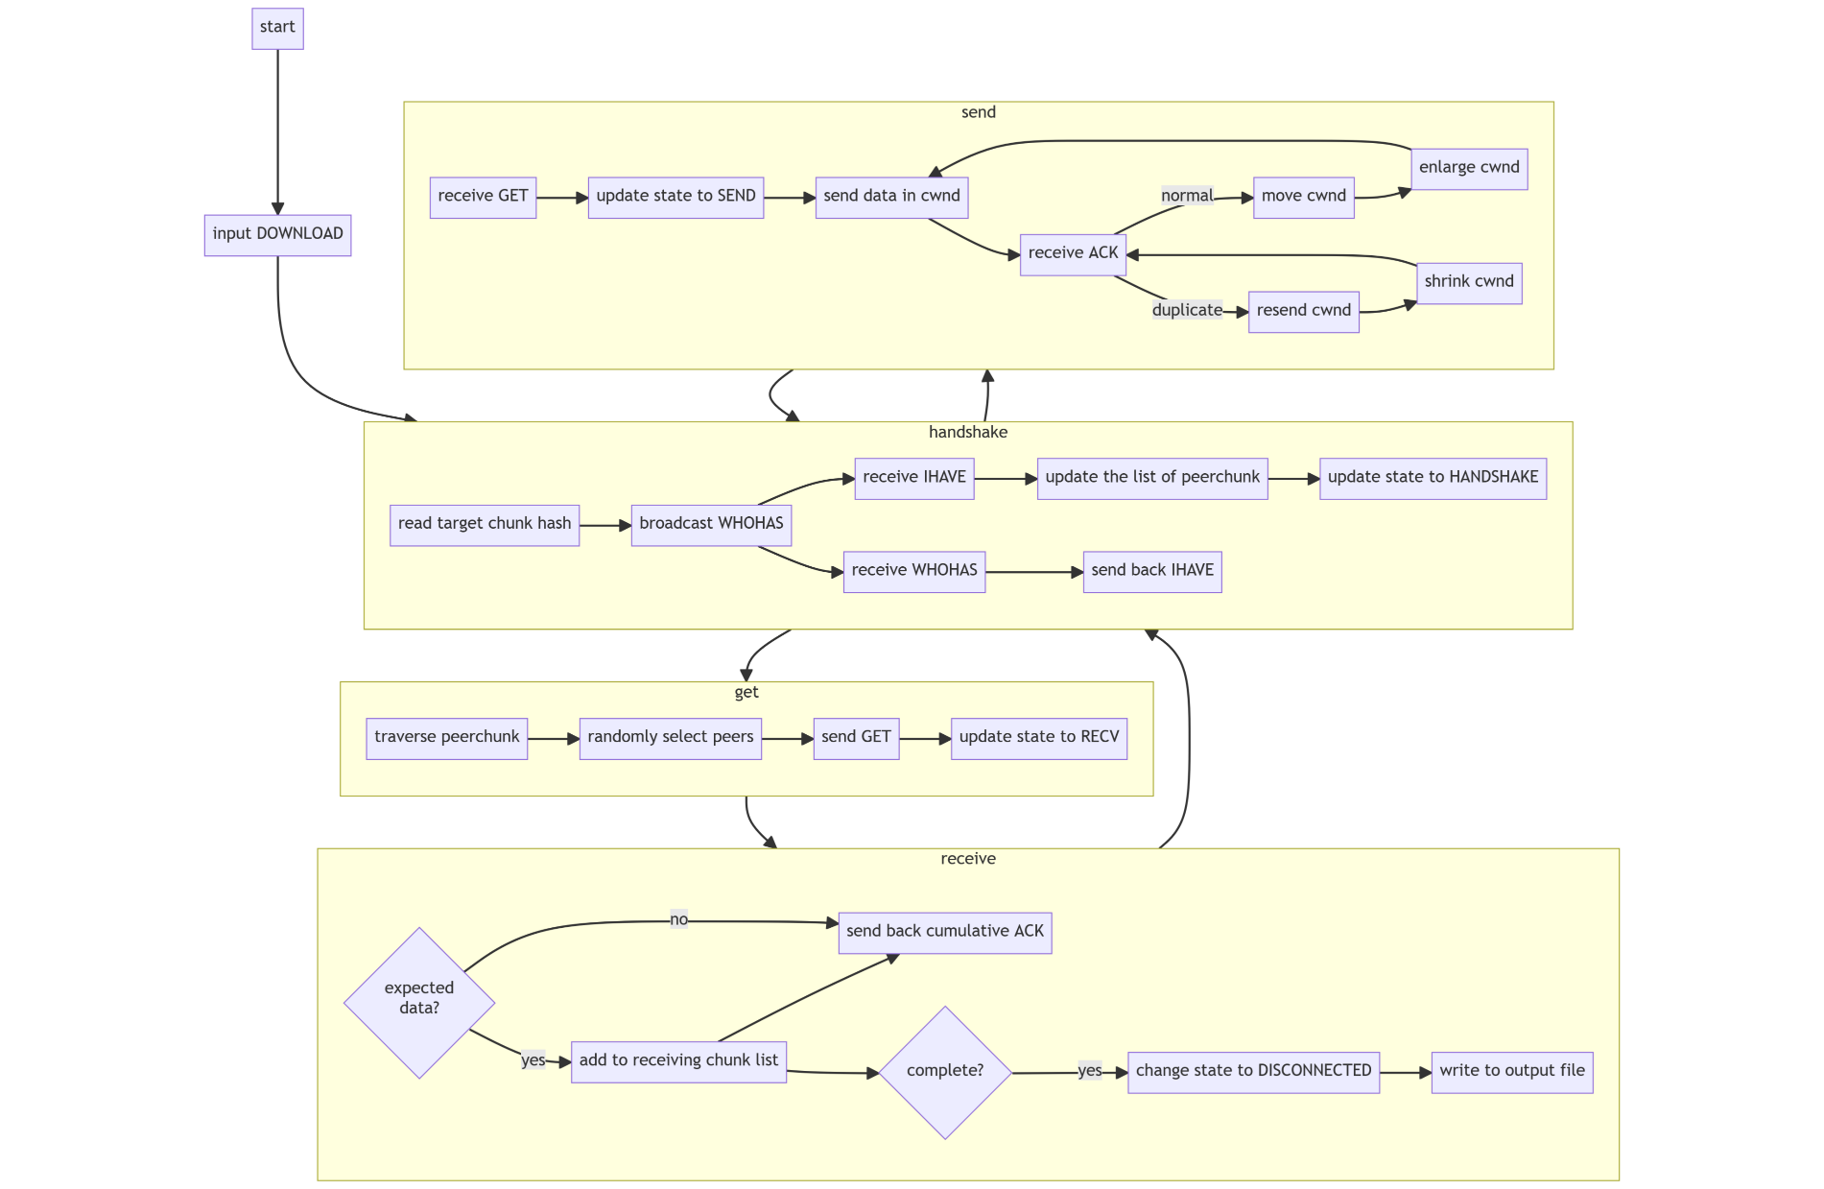

Slide 7

RDT & Congestion Control: GBN
P3
P2
P4
dupACKcnt = 3:
retransmit
rdt_timer: When timeout, retransmit
P1
P5
DATA:4
DATA:0
DATA:3
DATA:0
DATA:2
Cwnd = 1
DATA:1
ACK:1
P0
ACK:1
ACK:1
Exceped: data1

Slide 8
Crash Detection: Double Timeout
P3
P2
P4
P1
P5
ACK
ACK
P0
P0
crash_timer: When timeout, Crash_cnt +=1

Slide 9
02
Handshaking check

Slide 10
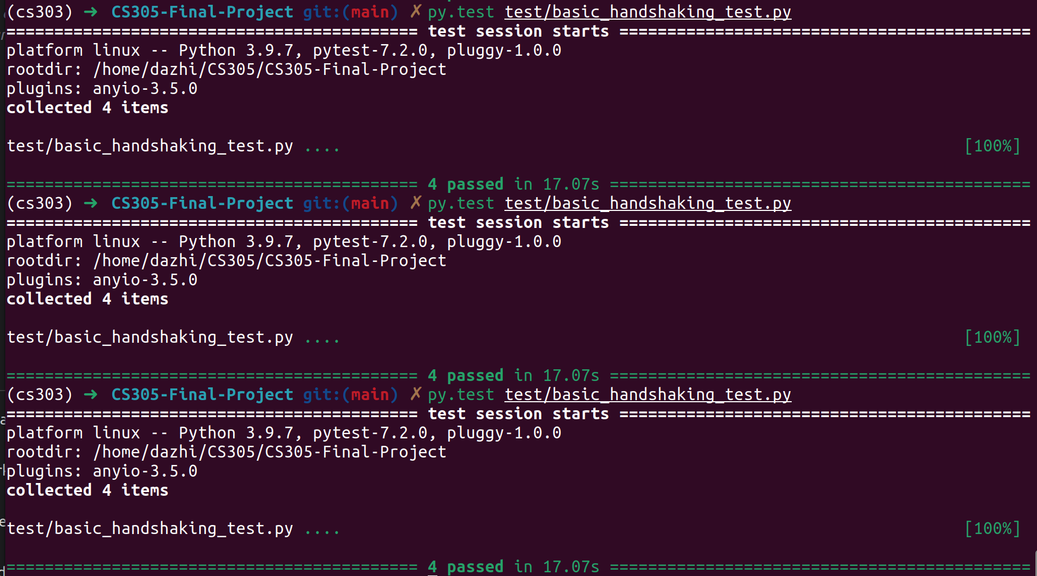
Handshaking check

Slide 11
03
Congestion Control check

Slide 12
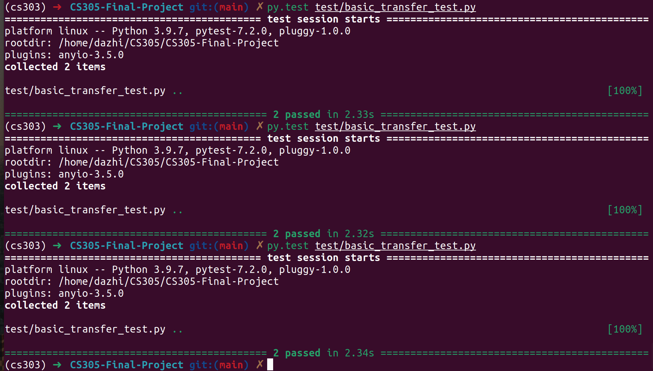
Congestion Control check

Slide 13
04
Concurrency check

Slide 14
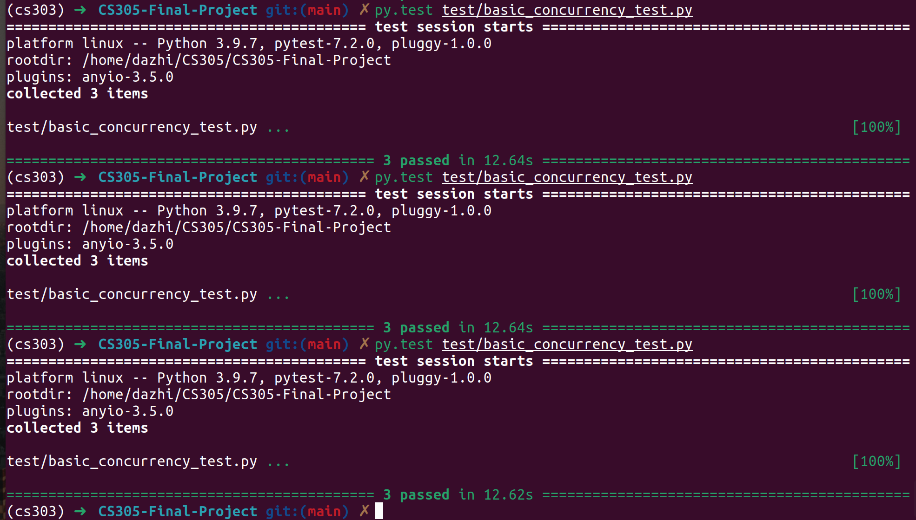
Concurrency check

Slide 15
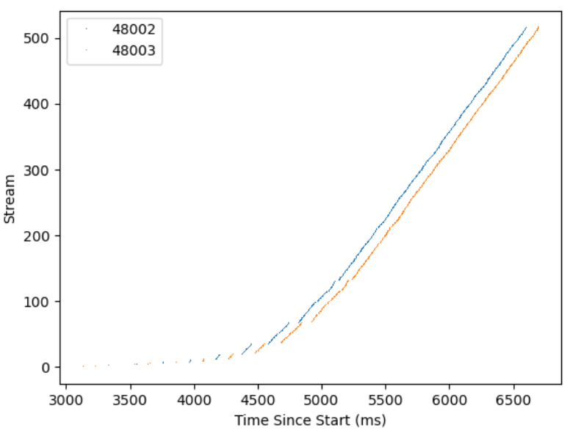
Concurrency check

Slide 16
05
Crash check

Slide 17
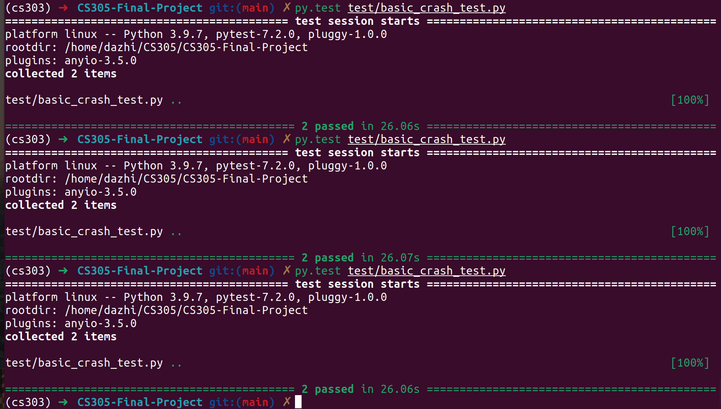
Crash check

Slide 18
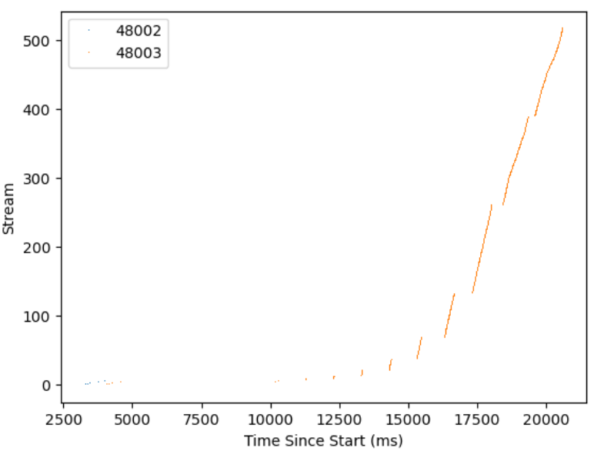

Slide 19
06
Comprehensive check

Slide 20
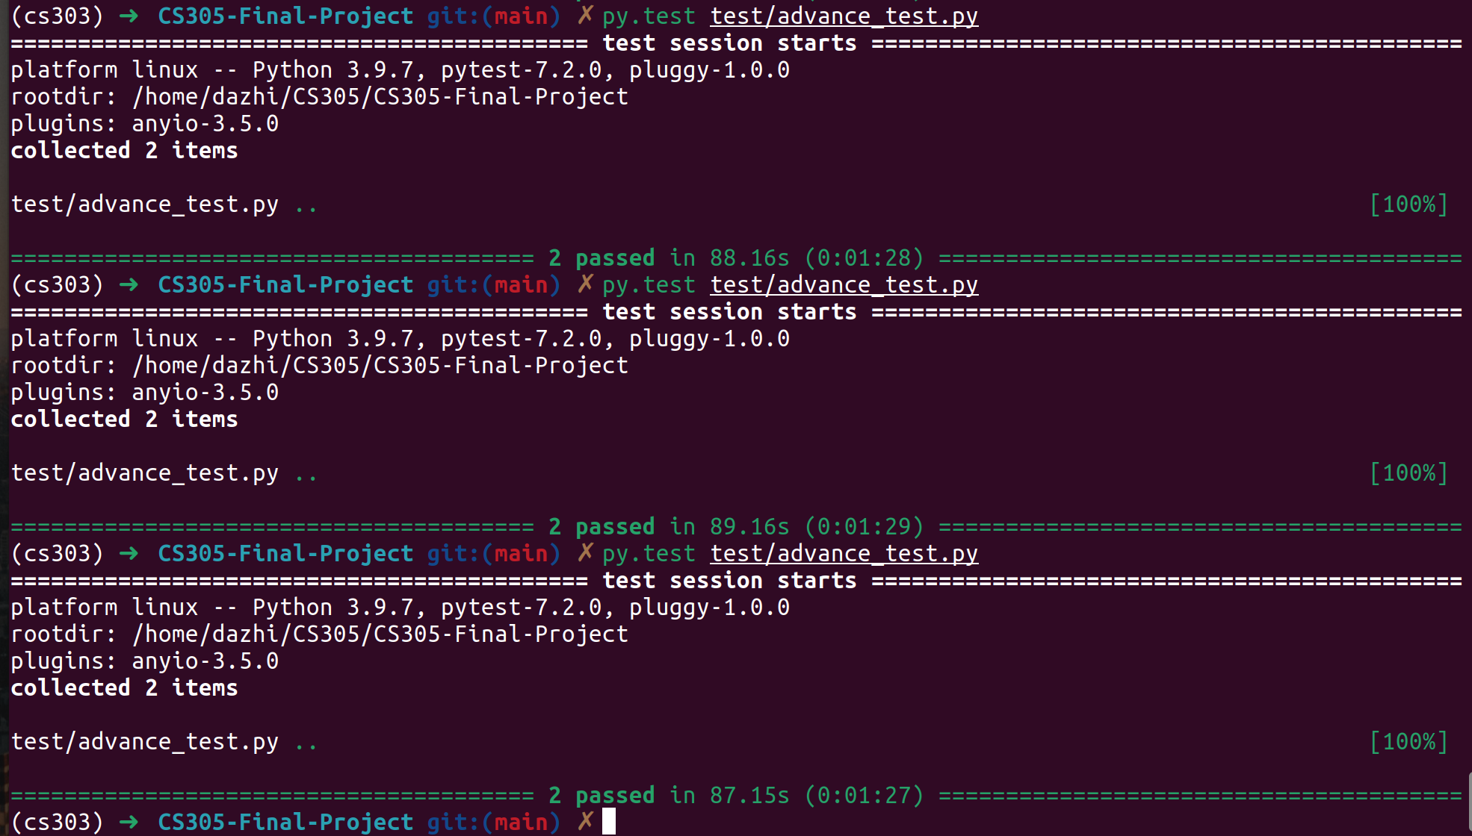
Comprehensive check

Slide 21
07
Bonus check

Slide 22
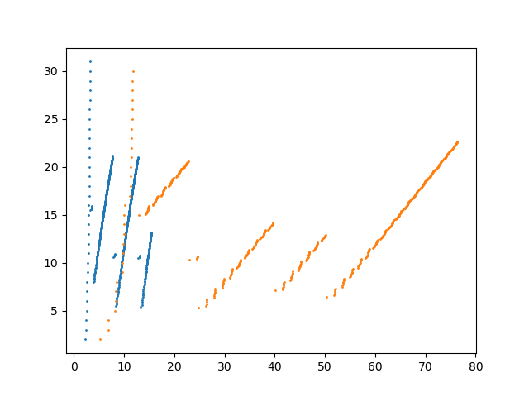
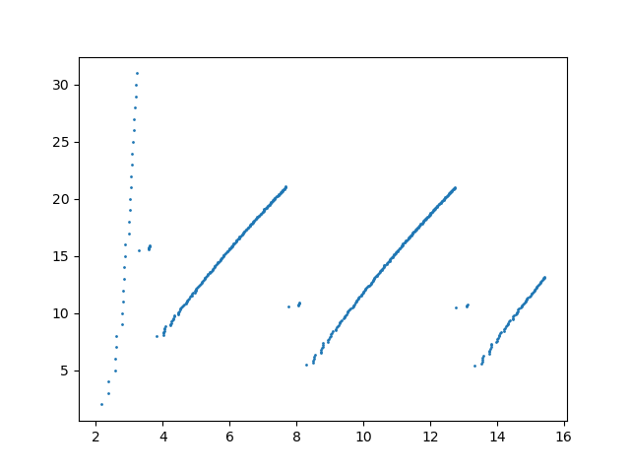

Slide 23
CS305 Final Project
感 谢 观 看

